Slide 1
Large Networks I:
Transmission
Chapter 5
Revised May 1999
Copyright 1998, 1999 Panko

Slide 2
Orientation
Chapter 4
  Simple PC network
  Single-hub LAN
  Simple servers
  Simple management
Chapter 5
  Transmission for large networks
  Multi-hub LANs
  Site Networks
  Enterprise Networks
Chapter 6
  Enterprise servers
  Management tools
  Security
  Quality of service

Slide 3
Multi-hub LANs
Multiple hubs
Multiple hubs in 10Base-T
Multiple hubs in 100Base-TX

Slide 4
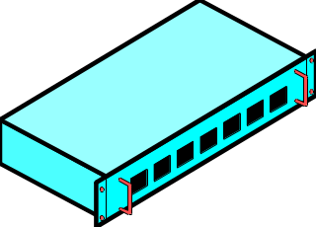
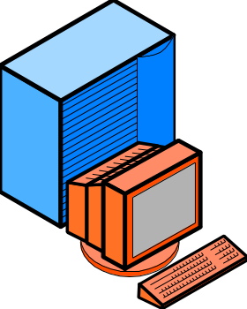

Hubs
Chapter 4
  Single-hub LAN
  200 meter maximum span
Chapter 5
  Multiple-hub LANs
  Increases distance span
100 m
100 m
100 m

Slide 5
Two Hubs
1. Station X transmits bit to Hub A
  Hub operates at the physical layer (bit by bit)
B
A
Y
1
X

Slide 6
Two Hubs in 802.3 10Base-T
2. Hub A broadcasts bit out all ports
B
A
Y
2
X

Slide 7
Two Hubs in 802.3 10Base-T
3. Uplink Port sends bit to Hub B
  Uplink ports are
  marked by an “X”
B
Uplink
Port
A
3
Y
X

Slide 8
Two Hubs in 802.3 10Base-T
4. Hub B broadcasts bit to all attached stations, including Y.
Note that all stations on both hubs receive the bit broadcast almost simultaneously
B
4
Y
A
X

Slide 9
Multiple Hubs in 10Base-T
Farthest stations in 10Base-T can be five segments (500 meters apart)
  100 meters per segment
  Separated by four hubs
100m
100m
10Base-T hubs
100m
500m, 4 hubs
100m
100m

Slide 10
Multiple Hubs in 10Base-T
No loops allowed
  Only one possible path between any two stations
4
6
AB=1,2,3,4,5
AC=1,2,3,4,6
BC=5,4,6
First two have
too many hubs
3
2
5
1
No!
C
No Loops
B
A

Slide 11
Multiple Hubs in 100Base-TX
Limit of Two Hubs in 100Base-TX
  Must be within a few meters of each other
  Maximum span ~200 meters
  Shorter distance span than 10Base-T
2 Collocated
Hubs
100m
100Base-TX
Hubs
100m

Slide 12
Site Networks
Latency and Congestion
Switches
Ethernet Switches
Ethernet Virtual LANs
ATM Switches
Hubs vs Switches vs Routers
Closing the Switch-Router Gap

Slide 13
Latency and Congestion
Ethernet is a Shared Media LAN
  Only one station can transmit at a time
  Even in multi-hub LANs
  Others must wait
  This causes delay
All Other
Stations
Must Wait
One Station Sends

Slide 14
Latency and Congestion
Delay is Called Latency
  Latency inevitably grows in shared media networks as stations are added
  Congestion becomes intolerable in 10Base-T LANs at 200 to 300 users
Latency
Number of Stations

Slide 15
Latency and Congestion
10Base-T Transmission Time
100Base-TX
  100Base-TX Station transmits a frame in 1/10 the time of a 10Base-T station
  Reduces the time others must wait to transmit for a given level of traffic
  So less congestion for a given traffic level
  But the maximum distance span is only 200 meters!
100Base-TX Transmission Time

Slide 16
Latency and Congestion
The Problem is Hub Operation
Signal comes in one port
But it goes out all ports
Even ports not serving the receiver
So only one station can transmit at a time

Slide 17
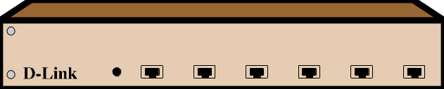

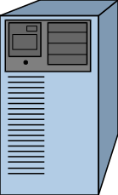
Switches
Signal comes in one port
Signal only goes out one port--the receiver’s
No broadcasting
No blocking of other ports

Slide 18
Switches
Multiple conversations can take place simultaneously
No need to wait! (unless the receiver’s port is busy)
Switches reduce latency and congestion
Simultaneous
Conversations
A-D and B-C
A
B
C
D

Slide 19
Types of Switches
Ethernet
ATM

Slide 20

Ethernet Switches
Compatible with Traditional Ethernet
  NICs designed for hubs work with switches
    No need to change NICs
  No need to change wiring to desktop
  Reduces learning time for organization
  Priced competitively
  Dominates site switching market
Ethernet NIC
Ethernet
Switch

Slide 21
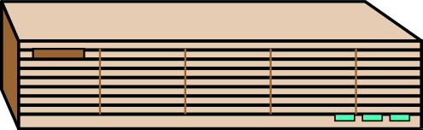
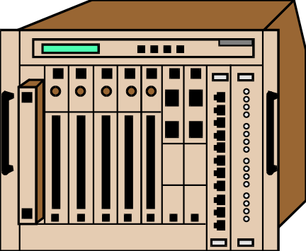
Ethernet Switches
Highly Scalable
10Base-T switches
  Competitive with 100Base-TX hubs in both cost and throughput
  Increasingly used to desktops
100Base-TX switches
  Higher performance (and price)
Gigabit Ethernet switches
  Very expensive

Slide 22
Ethernet Switches
Traditional Ethernet is Half-Duplex
  Only one station may transmit at a time
    No matter how large the network is
  Otherwise collisions
All Other
Stations
Must Wait
One Station Sends

Slide 23
Ethernet Switches
Ethernet Switches Cannot have Collisions
  Stations do not hear broadcast transmissions
  Only talk to one partner
  Can operate in full-duplex mode
  This requires full-duplex NICs
Full-Duplex
Ethernet NIC
Ethernet
Switch
Both

Slide 24
Ethernet Switches
Ethernet Switches Must be Arranged in a Hierarchy (or Daisy Chain)
  10Base-T, 100Base-TX, and gigabit Ethernet
N
Hierarchy
N
= New (not in book)

Slide 25
Ethernet Switches
Ethernet Switches Must be Arranged in a Hierarchy (or Daisy Chain)
  10Base-T, 100Base-TX, and gigabit Ethernet
N
Daisy Chain
N
N
= New (not in book)

Slide 26
Ethernet Switches
Ethernet Switches Must be Arranged in a Hierarchy (or Daisy Chain)
  10Base-T, 100Base-TX, and gigabit Ethernet
N
Combined
Hierarchy and
Daisy Chain
Daisy Chain
N
N
= New (not in book)

Slide 27
Ethernet Switches
No limit on number of Ethernet switches between farthest stations
  So no distance
  limit on size of
  switched networks
N

Slide 28
Ethernet Switches
Ethernet Switches Must be Arranged in a Hierarchy (or daisy chain)
  Only one possible path between any two stations, switches
1
Path=4,5,2,1,3
2
3
4
5
6

Slide 29
Ethernet Switches
Only one possible path between stations
  No need to calculate alternative routes
  Makes switches simple, fast, inexpensive

Slide 30
Ethernet Switches
Simple Table Lookup
  Very fast
  Places a low processing load on the switch
  Switches are both fast and economical
1001 ...
Destination Address
Port
10111000,,,
1
10010010 ...
2
01010101 ...
1

Slide 31
Ethernet Switches
Only one possible path between stations
  No way to route around failures, congestion
  No way to optimize route for price, etc.

Slide 32
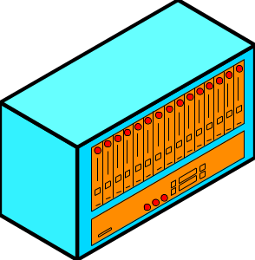
Ethernet Virtual LANs
Security Problem with Ethernet Switches
  Any client can reach any server
  No security beyond passwords
Marketing
Accounting
Marketing
Accounting

Slide 33
Ethernet Virtual LANs
Problems with Ethernet Switches
  Servers frequently send broadcast messages advertising their presence
Marketing
Accounting
Marketing
Accounting

Slide 34
Ethernet Virtual LANs
Problems with Ethernet Switches
  All stations should process such broadcast messages, even on switches. Causes congestion.
Marketing
Accounting
Marketing
Accounting

Slide 35
Note!
Switches Generally Prevent Congestion
  Messages go out only one port
  True for Ethernet frames with normal single-station MAC addresses
Broadcast Messages are Broadcast Anyway
  MAC address is 48 ones (11111111…)
  All stations should process such messages
  So switch broadcasts out all ports
  Congestion results

Slide 36
Ethernet Virtual LANs
Virtual LANs
  Stations are divided into groups (VLANs)
  Servers and the clients they serve
Marketing
VLAN 2
VLAN 1=
Accounting
VLAN 2=
Marketing
Accounting
VLAN 1
Accounting
VLAN 1
Marketing
VLAN 2

Slide 37
Ethernet Virtual LANs
Security
  Clients can only reach servers on their own VLANs
Marketing
VLAN 2
No!
Accounting
VLAN 1
Accounting
VLAN 1
Marketing
VLAN 2

Slide 38
Ethernet Virtual LANs
Congestion Control
  Servers only broadcast to their own clients
  Prevents broadcast congestion
Marketing
VLAN 2
No!
Accounting
VLAN 1
Accounting
VLAN 1
Marketing
VLAN 2

Slide 39

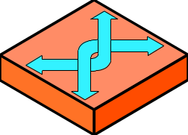
Ethernet VLANs and Routers
Routers
  Each VLAN acts is an IP subnet
  Router must connect stations on different VLANs
VLAN 3
(Subnet 3)
VLAN 2 (Subnet 2)
VLAN 1 (Subnet 1)

Slide 40
Ethernet VLANs and Routers
Routers
  Physically connect the switches that implement VLANs

Slide 41
Ethernet VLANs: Perspective
For Ethernet switches
Provide improved security
Reduce congestion from Ethernet broadcast messages
Easy administration: When station moves physically, stays on its VLAN automatically
Good at separating stations; usually require routers to connect stations on different VLANs
N

Slide 42
Ethernet Choices
10Base-T Hubs to the desktop
  Least expensive alternative
  Too much congestion for larger LANs
100Base-TX Hubs to the desktop
  Only slightly more expensive than 10Base-T hubs
  Better choice for most new installations
  Small distance span (200 meters)

Slide 43
Ethernet Choices
10Base-T Switches to the desktop
  Price- and performance-competitive with Ethernet 100Base-TX hubs
  Difficult choice between 10Base-T switches and 100Base-TX hubs today
  Switch networks not limited in size like hub networks
100Base-TX Switches to the desktop
  Still quite expensive today
N

Slide 44
Types of Switches
Ethernet
ATM

Slide 45

ATM Switches
Asynchronous Transfer Mode
Has fixed-length frames are called cells
  Always 48 octets of payload
  Always 5 octets of header
  So always 53 octets total
Fixed length allows switches to process cells very rapidly using parallel circuitry
Payload (48 octets)
Header
(5 octets)
ATM Cell

Slide 46
ATM Switches
Small cell reduces latency (delay) at each switch.
  Some processing must wait for the entire frame arrives
  Short frames finish arriving quickly
  Critical for voice

Slide 47
ATM Switches
Highly Scalable
  25 Mbps to a few gigabits per second
Very sophisticated
  Quality of service (QoS)--delivery guarantees for maximum latency, exact timing between adjacent bits.
  Ethernet is only a best-effort service today

Slide 48
ATM Switches
Hardware is very expensive because of complexity
Retraining and ongoing management are very expensive because of complexity
ATM has high overhead (extra characters)
  5 overhead octets for 48 data octets
  Actually even worse (see Module E)

Slide 49
ATM Switches
Unfortunately, very expensive
  Has lost the desktop
  It is usually cheaper to use high-capacity Ethernet switches so that latency does not grow to the point where QoS prioritization is critical
  Beyond the desk, only where service quality is critical

Slide 50
ATM Switches
SOMETIMES Arranged in a Hierarchy
  Only single possible path between stations
  Simplifies operation and allows lower cost
ATM
Cell

Slide 51
ATM Switches: Virtual Circuits
SOMETIMES Arranged in a Mesh
  But all traffic between two stations still is consigned to a path called a virtual circuit that is set up before the first frame transmission
ATM
Cell
Virtual
Circuit

Slide 52
ATM Switches
Virtual Circuits Mean that there is Only a Single Possible Path between Any Two Stations
  Virtual circuits simplify operation and lower switch cost
ATM
Cell
Virtual
Circuit

Slide 53
Question
In what Two ways does ATM limit traffic to a single path?
  SOMETIMES by arranging switches in a hierarchy
  ALWAYS by using virtual circuits

Slide 54
ATM Switches
Permanent Virtual Circuits (PVCs)
  Designed to operate for weeks, months, or years
  Used between sites in a corporation
  Simplest and least expensive administratively because rarely changed
  Most widely used form of virtual circuit

Slide 55
ATM Switches
Switched Virtual Circuits (SVCs)
  Established just as communication starts
  More flexible than PVCs in what computers a station can reach
  Expensive because each setup costs money
  Until recently, not much used because of complexity, added cost

Slide 56
ATM Switches
ATM Frame Header
  Does NOT have a destination address field
  Instead, has two fields that together contain a hierarchical virtual circuit number
  Like a route number on a bus--names the route, not the destination
ATM Header
Virtual Circuit Number

Slide 57
Ethernet Fights Back
Mod C
IEEE 802.1 Working Group is Adding “Tag” Fields to Ethernet Headers (and other 802 MAC layer headers)
  Standardize VLANs identification
Ethernet Header
Tag Fields

Slide 58
Ethernet Fights Back
Mod C
IEEE 802.1 Working Group is Adding “Tag” Fields to Ethernet Headers (and other 802 MAC layer headers)
  Sets frame priority so that the most time- sensitive data will get through first
  Not as sophisticated as ATM quality of service, but a major step forward
Ethernet Header
Tag Fields

Slide 59
Routers
Operate in a Mesh
  Many possible alternative routes between two stations
Packet
Only One of Many
Possible Alternative Routes

Slide 60
Routers
Benefits of Alternative Routes
  Can route around a router or trunk line failure
  Can route around congestion
  Can select an optimal route based on cost, latency, security, or other goal

Slide 61
OSI Layers
Hubs operate at OSI Layer 1
Single possible path between any two stations (single data link)
Physical layer (OSI Layer 1)--only looks at individual bits. Broadcasts them back out
Switches operate at OSI Layer 2
Single possible path between any two stations (single data link)
Data Link layer (OSI Layer 2)--must analyze frame to read destination address to select a port.

Slide 62
Switches and Routers
Switches Operate at OSI Layer 2 (Data Link)
Limited to a single possible path (data link) between stations
Flat 48-bit address space, so no subnetting
Routers Operate at OSI Layer 3 (Internet)
Multiple possible alternative routes between stations
Hierarchical addressing: network and subnet parts

Slide 63
Switching is Easy
Look up destination address in incoming frame
Do a simple table lookup linking the destination address and a port
  Table lookups are very fast
Send the frame out the selected port (Port 1)
Simplicity means low cost even for high numbers of frames
per second
DA
Port
234
2
518
518
1

Slide 64
Routing is Complex
Look up the destination host address in the packet
Do complex calculations to select the best possible out port on the router, given where the packet should go next considering things such as congestion
This complexity requires a complex and expensive router for relatively low packet rates
?

Slide 65
Switches Versus Routers
Switches
Fast
Inexpensive
No benefits of alternative routing
No hierarchical addressing
Routers
Slow
Expensive
benefits of alternative routing
Hierarchical addressing
“Switch where you can; route where you must”

Slide 66
Closing the Gap
Layer 3 switches
  Accept IP packets at edge switches
  Switch internally in the switched network
  Send IP packets out at edge switches
Edge Switch
Edge Switch
IP packet

Slide 67
Closing the Gap
Layer 3 switches
  Accepts standard IP packets, gives speed of switching
  ATM offers the Multiprotocol over ATM (MPOA) to standardize layer 3 switching
Edge Switch
Edge Switch
IP packet

Slide 68
Closing the Gap
Flow Routers route all IP packets in a persistent flow the same way (like virtual circuit)
  Cheaper than routing each packet separately
  Some recognize flows by activity patterns
  The Multiprotocol Label Switching (MPLS) standard adds tag fields to IP packet headers to label flows
Flow

Slide 69
Closing the Gap
ASIC Routers handle full routing processes in hardware for switch-like speeds
  Hardware processing is faster than software processing in almost everything
  Made possible by new attractive costs for application-specific integrated circuits
  Also has general processor for handling new functions in software

Slide 70
WAN Principles
Carriers
Leased Line Meshes
Public Switched Data Networks
Circuit vs Packet-Switched PSDNs
Reliable vs Unreliable PSDNs
Dedicated vs Dial-Up PSDNs
Virtual Private Networks (VPNs)

Slide 71
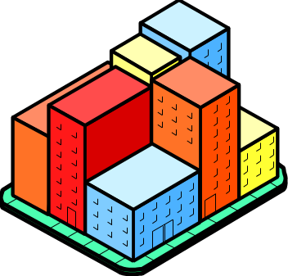
Carriers
You can only install wires on your own property
To carry signals between sites or to customers, you must use a carrier.
A carrier carries traffic for a price.
Carrier

Slide 72
Leased Lines
Leased lines
  Point-to-point communication
    Limits who you can talk to
  Lower cost per minute than dial-up
  Higher speeds than dial-up
Leased Line

Slide 73
Leased Line Meshes
If you have several sites, you need a mesh of leased lines
Mesh
Leased Line

Slide 74
Leased Line Speeds
Mod E
Largest Demand is 64 kbps to about 2 Mbps
64 kbps digital leased lines
T1 (1.544 Mbps) digital leased lines
  24 times effective capacity of 64 kbps
  Only about 3-5 times cost of 64 kbps
Fractional T1
  Fraction of T1’s speed and price
  Often 128, 256, 384 kbps

Slide 75
Leased Line Speeds
Mod E
T3: is the next step
  44.7 Mbps in U.S.
Europe has E Series
  E1: 2.048 Mbps
  E3: 34 Mbps
SONET/SDH lines offer very high speeds
  156 Mbps
  622 Mbps
  Faster

Slide 76
Problems of Leased Lines
With many sites, meshes are expensive and difficult to manage
With N sites, N*(N-1)/2 leased lines for a mesh
User firm must handle switching and ongoing management
Sites
Lines
5
10
10
45
25
300

Slide 77
PSDNs
Public Switched Data Networks
  Designed for data rather than voice
  Site-to-site switching is handled for you
  You connect each site to the “cloud” (No need to know internal details)
PSDN

Slide 78
PSDNs
Connect each site to the PSDN using a leased line
  Only one leased line per site
  With N sites, you only need N leased lines, not N* (N-1)/2
1 Leased
Line
PSDN

Slide 79
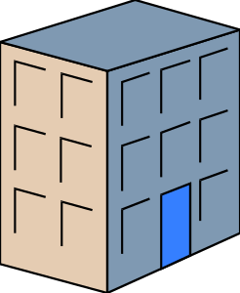
PSDNs
Point of Presence (POP)
  Place where you connect to the cloud
  May be several in a city
  May not have any POP close
  Need leased line to POP
  Separate from PSDN charges
Leased
Line
PSDN

Slide 80
Circuit-Switched PSDNs
End-to-End Capacity is Guaranteed
  If you need it, it is always there
  When you don’t need it, you still pay for it
  Expensive for data traffic, which usually has short bursts and long silences
A bcd efg
PSDN

Slide 81
Packet Switched PSDNs
Messages are divided into small units called packets (sometimes, frames)
  Short packets load switches more effectively than fewer long messages

Slide 82
Packet Switched PSDNs
Packets are multiplexed on trunk lines
  Cost of trunk lines is shared
  Packet switching lowers transmission costs
  Dominates PSDN service today
Multiplexed
Trunk Line

Slide 83
Packet Switched PSDNs: Virtual Circuits
All commercial packet switched PSDNs use virtual circuits
  No routing decisions for individual packets
  Reduces switching costs.
Virtual
Circuit

Slide 84
Unreliable PSDNs
All commercial PSDNs are Unreliable
  (Obsolete X.25 PSDN technology was reliable)
  No error correction at each hop between switches
  Reduces costs
  Note that both virtual circuits and unreliable service reduce costs
N
The material in this slide is not in the book

Slide 85
Dedicated-Connection PSDNs
Site is always connected to the PSDN
  Can always transmit and receive
  All PSDNs except ISDN provide dedicated connections
Dedicated
Connection
PSDN

Slide 86
Dial-Up Connection PSDNs
Must connect each time you wish to transmit
  Like dial-up telephone service
  Do not pay for service when not connected
  Delay whenever you connect to the network
  Only ISDN is dial-up
Dial-Up
Connection
PSDN

Slide 87
WAN Products
ISDN
Frame Relay
ATM
Virtual Private Networks (VPNs)

Slide 88
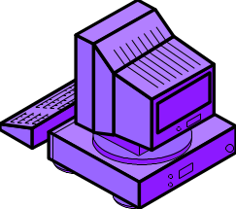


ISDN
Integrated Services Digital Network
2B+D Basic Rate Interface (BRI) to the desktop
  Two 64-kbps B channels
  Can be bonded for 128 kbps service
  One 16-kbps D channel, usually for supervisory signals
64
kbps
BRI
2B+D
64
kbps
ISDN Modem

Slide 89

ISDN
Primary Rate Interface (PRI)
  Connection between firm and ISDN carrier
  23B+D (on a T1 line)
  Twenty-Three 64 kbps B channels
  One 64 kbps D channel for supervision
2B+D
23B+D
ISDN
BRI
PRI

Slide 90
ISDN
Circuit-Switched
  Dedicated capacity
  Expensive for data
Dial-Up Connection
  Must connect each time you wish to communicate
Unreliable
Only Popular PSDN that is either circuit-switched or dial-up

Slide 91

Frame Relay
Most Popular PSDN Today
  Offers speeds of 64 kbps to about 2 Mbps. This is the range of greatest corporate demand
  Priced attractively
  Both reasons
  are critical

Slide 92
Frame Relay
Packet Switched
  Uses virtual circuits to cut costs
  Unreliable. Does no error checking. Further cuts costs
Dedicated Connections
N

Slide 93
ATM
Like Frame Relay:
  Packet switched
  Virtual circuits
  Dedicated Connections
Unlike Frame Relay
  Much faster
    45 Mbps, 156 kbps, 622 kbps, several Gbps
  May offer quality of service (QoS) guarantees
    Maximum latency for time-critical applications
    Exact cell-by-cell timing

Slide 94
ATM
Very Expensive
  Complexity because of basic mechanisms
  Complexity because of quality of service mechanisms

Slide 95
Frame Relay and ATM
Most Vendors Offer Both
Frame Relay at lower speeds
ATM at higher speeds
In general, a smooth price-speed
curve across the two services
At some speed, may offer both
  If so, price them the same
  But ATM has higher overhead
FR
ATM
Price
Speed

Slide 96

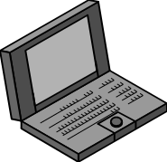
VPNs
Virtual Private Networks
  Use the Internet for transmission instead of a PSDN
Internet

Slide 97
VPNs
Why use the Internet?
  Inexpensive
  Business partners are already connected to the same network (the Internet)
    May use different PSDNs, but everybody is connected to the Internet

Slide 98
VPNs
Problems with the Internet
  Congestion: slows transmissions
  Reliability: cannot always connect, sometimes fails during transmissions
  Lack of security

Slide 99
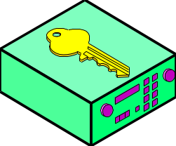
VPNs
IETF developing IPsec security standards
  Security server at each site
  Remote computers have IPsec software
Security Server
IPsec Software

Slide 100
VPNs
IPsec
  Creates a “tunnel” of secure transmission through the non-secure Internet
Secure Tunnel

Slide 101
Virtual Private Networks
Other Problems Remain
Internet Congestion is Still a Problem
  Internet throughput tends to be low
Internet Reliability is Low
  Cannot get connections
  Backbone fails occasionally

Slide 102
Virtual Private Networks
Alternative
  Avoid the congested backbone
  Use one ISP that serves all sites
  Should offer QoS service level agreement (SLAs): guarantees in writing with specified penalties for noncompliance
Site 1
ISP
Site 2

Slide 103
Virtual Private Networks
Alternative
  Avoid the congested backbone
  Use ISPs that “peer” with one another: connect with one another not through the Internet backbone
  May offer end-to-end SLAs
Site 1
ISP A
ISP B
Site 2
Peering

Slide 104
Recap: Multi-Hub Networks
Multi-Hub Networks
10Base-T
  500 meter distance span
  But congested if more than 200-300 users
100Base-TX
  Reduces congestion
  Higher burst speed for multimedia, etc.
  Only 200 meter distance span

Slide 105
Recap: Congestion and Latency
Congestion and Latency
  Shared media networks
  Only one station may transmit; others must wait
  Latency is delay

Slide 106
Recap: Congestion and Latency
Switches
  Multiple conversations can take place simultaneously
  No waiting to transmit
  No latency and congestion as traffic grows
  No maximum size for switched networks

Slide 107
Recap: Ethernet Switches
Ethernet Switches
  Dominate site switching today
  Cheapest switching alternative
    Switches themselves are relatively inexpensive
    Work with existing NICs and wiring to desktop, so no need to upgrade
    Minimizes relearning time
  Adequate for most corporate needs
    Cheapest is not enough

Slide 108
Recap: Ethernet Switches
Ethernet Switches
  Hierarchical organization to give single path between any two stations
  Virtual LANs (VLANs) reduce broadcasting and security concerns but can make interconnection difficult

Slide 109
Recap: ATM Switches
ATM Switches
  Roughly same speed range as Ethernet switches
  Quality of service (QoS) guarantees
  Sometimes uses hierarchical organization and ALWAYS uses virtual circuits to give a single possible path

Slide 110
Recap: Layers of Operation
Hubs operate at layer 1 (Physical)
  One bit at a time
  Single possible path between sites
Switches operate at layer 2 (Data Link)
  Must analyze frames (addresses)
  Single possible path between sites
  Flat addressing so no subnetting
Routers operate at layer 3 (Internet)
  Multiple alternative routes
  Hierarchical addressing for subnetting

Slide 111
Recap: Closing the Switch-Router Gap
Price-Performance Gap
Layer 3 Switches
  Carry IP packets over switches
Flow Routers
  Native IP routing at switching speeds
  Do not route packets individually; route flows
  Must modify IP, for instance, may add tag
ASIC Routers
  Hardware for high-speeds, full IP processing

Slide 112
Recap: WAN Principles
Carriers
  Carry signals between sites
Leased Lines
  Point-to-point connections offering low costs per minute
Meshes of leased lines
  If N sites, N(N-1)/2 leased lines for full mesh
  High management costs

Slide 113
Recap: WAN Principles
Public Switched Data Network (PSDN) Clouds
  Reduced management cost
  Still need one leased line per site
Circuit-versus-Packet Switching in PSDNs
  Dedicated capacity versus low cost
Unreliable-versus-Reliable Service
  All popular PSDNs are unreliable
Dedicated-versus-Dial-Up Connections
  All PSDNs but ISDN use them
N

Slide 114
Recap: WAN Principles
The Need to Minimize Switching Costs
  Switch costs dominate total costs
  Unreliable operation reduces the load on each switch
  Virtual circuits minimize the load on each switch
  This is why most commercial ISDNs both are unreliable and use virtual circuits

Slide 115
Recap: PSDN Products
ISDN: circuit-switched and dial-up
  Others are all packet-switches
  Others all use dedicated connections
  Slow: only 64 kbps to 128 kbps
Frame Relay
  Most widely used PSDN
  In speed range of highest corporate demand (64 kbps - 2 Mbps)
  Attractively priced

Slide 116
Recap: PSDN Products
ATM
  Higher speeds and costs
  Smooth speed-price continuum with Frame Relay
Virtual Private Networks (VPNs)
  Uses the Internet for transmission
  Adds security tunnels
  Problems of congestion and reliability remains
    Use single ISPs and peering

Slide 117
Orientation
Chapter 4
  Simple PC network
  Single-hub LAN
  Simple servers
  Simple management
Chapter 5
  Transmission for large networks
  Multi-hub LANs
  Site Networks
  Enterprise Networks
Chapter 6
  Enterprise servers
  Management tools
  Security
  Quality of service

